Slide 1
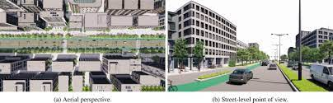
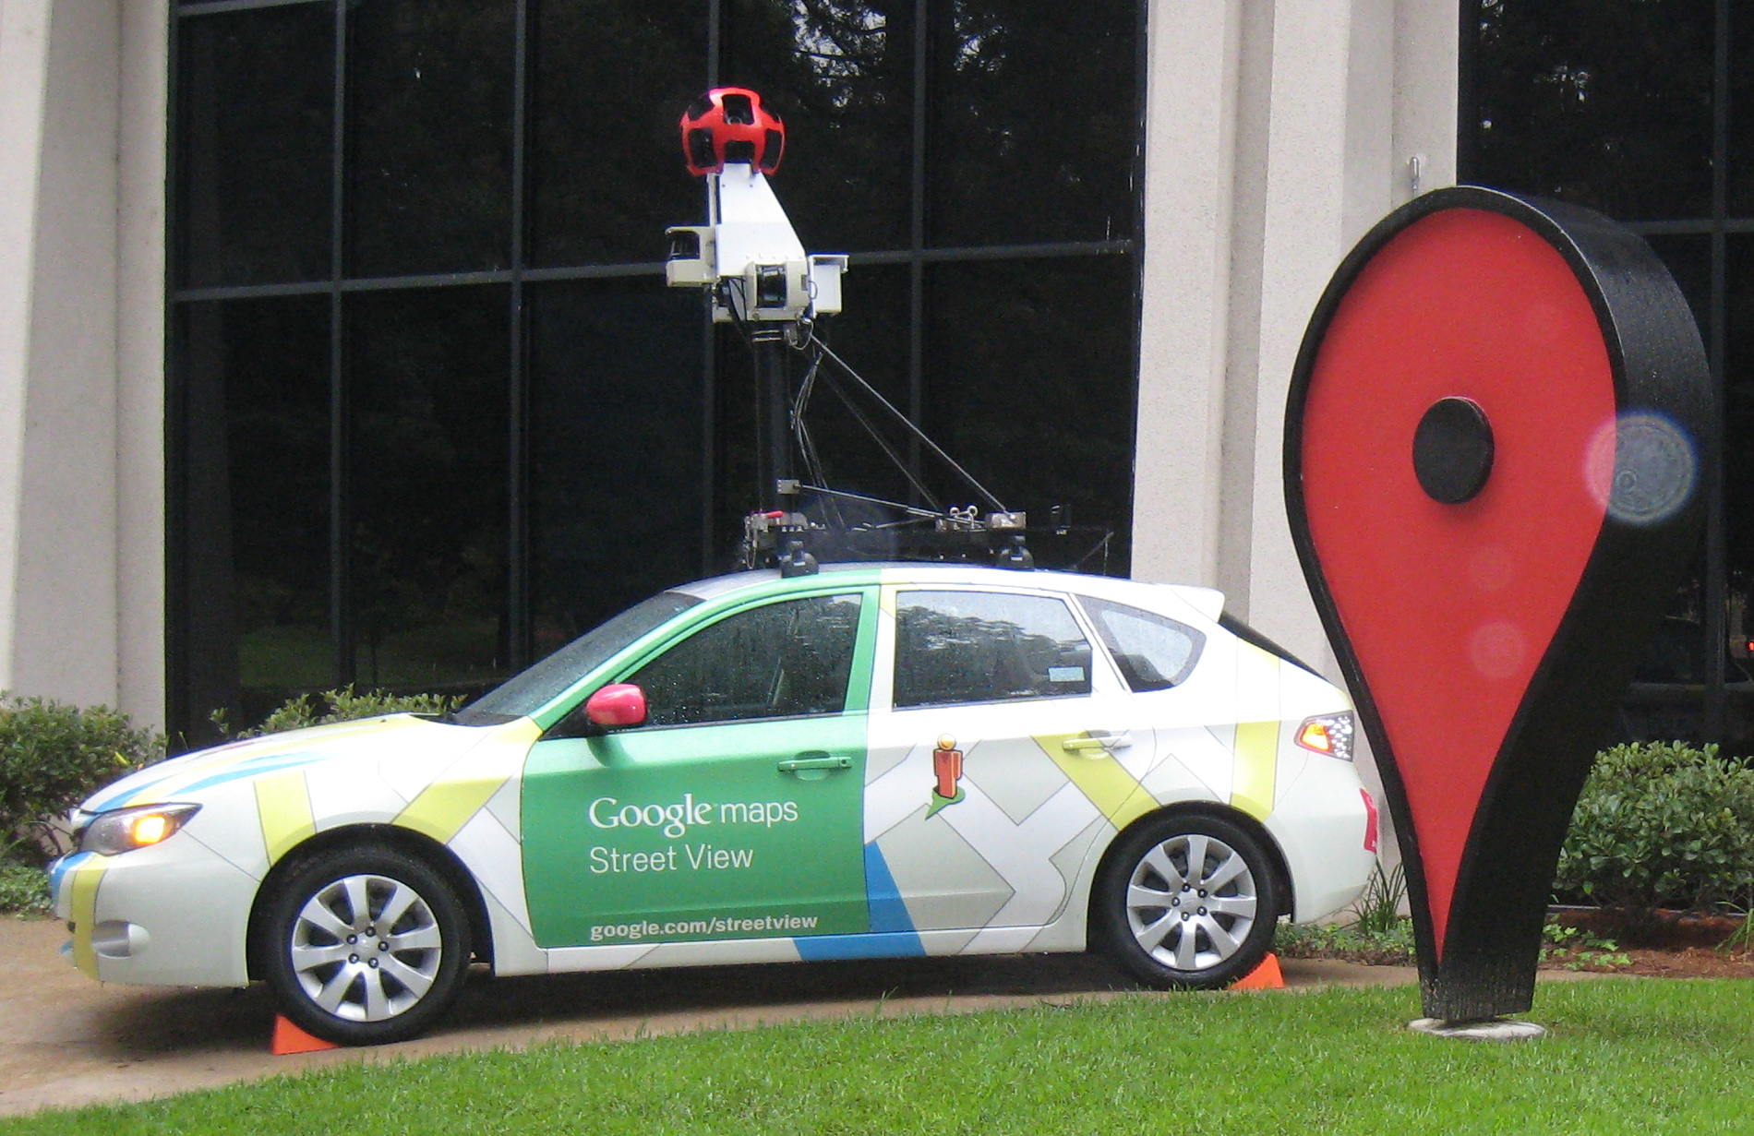
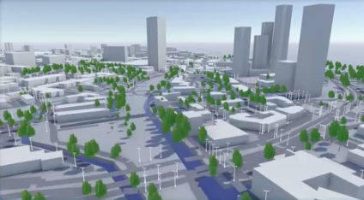
Problem statement
Figure 5 Google aerial and street view images
A more cost-effective and practical approach involves leveraging Google Street View, satellite images, computer vision, and machine learning models for object detection to obtain foliage information.
This study introduces a computer vision-based machine learning method using open source or low-cost resources, Google Street View images, and satellite images to determine foliage and tree height.
(a) Aerial perspective
(b) Street view perspective
Figure 1 Digital Twin Representation of Foliage
Note. (MWC23 – Intelligent, 2023).
Notes:
In response to the multifaceted challenges associated with mmW networks and the importance of optimizing foliage-related aspects, the current research endeavors to propose a pragmatic, cost-effective solution that harnesses the power of technology to enhance network planning and deployment. By integrating Google Street View and satellite images with advanced computer vision and machine learning techniques, the current study introduces an innovative approach that not only mitigates the financial burden but also opens up exciting possibilities for enhanced performance and precision.
As foliage significantly affects higher frequency networks, such as mmW, the study focuses on creating a digital twin (DT) of an environment that contains foliage.
Network operators planning to deploy high-frequency networks may use this DT to strategically place nodes for better coverage and user experience.
The study utilizes computer vision-based machine learning methods that use open-source or low-cost resources.
Google Street View and satellite images estimate foliage presence and tree height (Aikoh et al., 2023; Brinkhoff, 2016).
A future extension of the DT concept could include data on building facades, traffic signs, road markers, and pedestrian crossings.

Slide 2
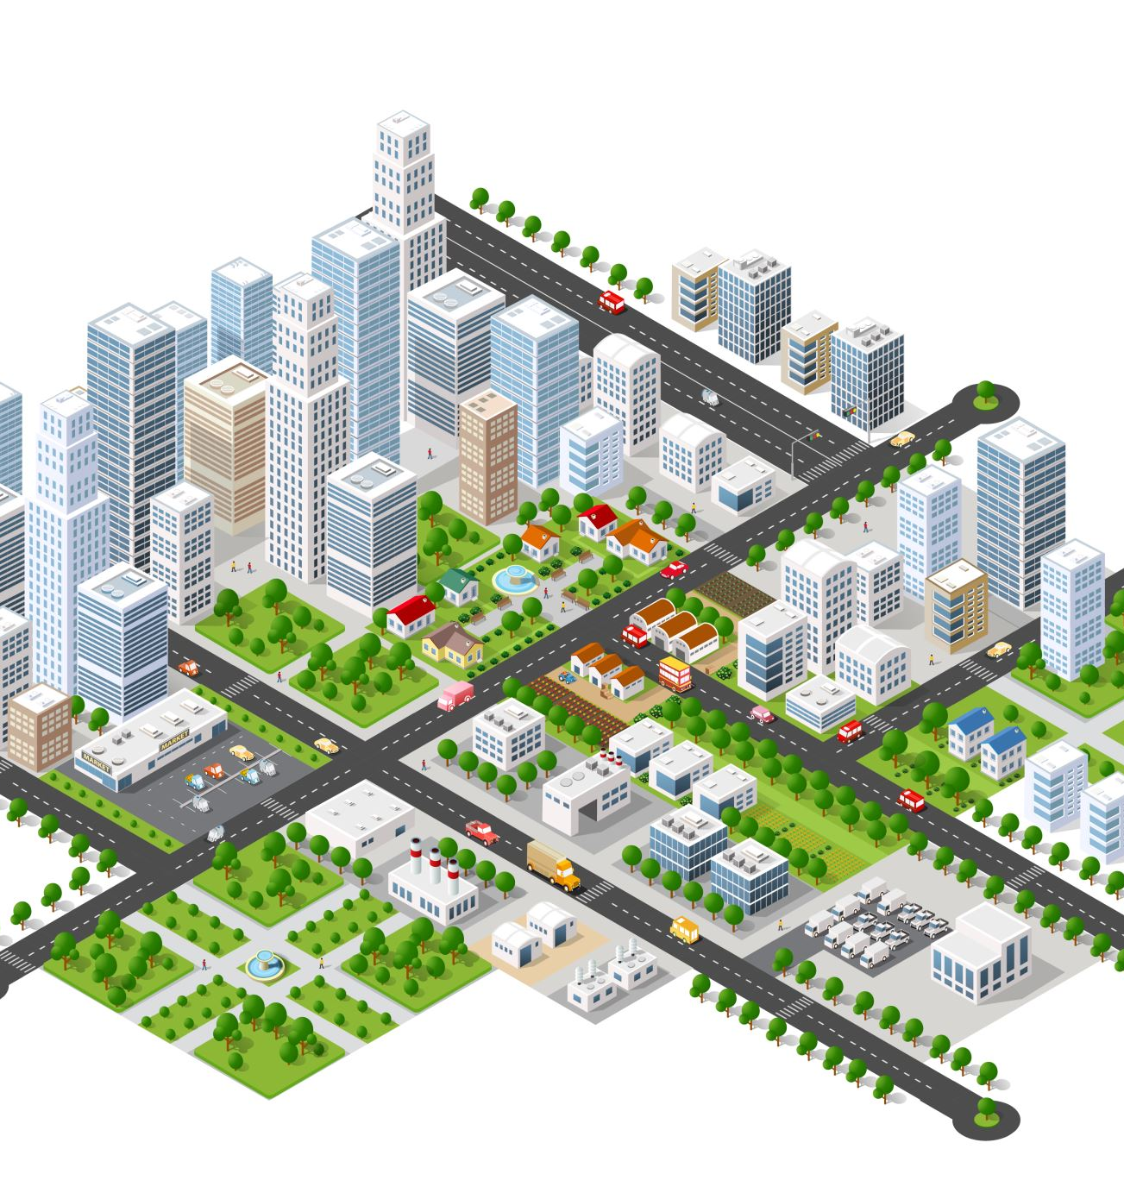
Research Purpose
Build a digital twin of the environment to estimate path loss caused by foliage in high-frequency millimeter-wave network planning.
Utilize Google aerial and street view images and modern image analysis techniques.
Achieve foliage information comparable to LiDAR or UAV images, which are costlier.
Employ machine learning models with instance semantic segmentation for foliage detection.
Segment images into distinct regions or objects for pixel-level scene understanding.
Use Mask R-CNN framework for instance segmentation.
Conduct the study in Philadelphia, known for its greenery with approximately 2.9 million trees.
Notes:
The primary objective of this research is to develop a digital replica of an environment, complete with foliage data, to facilitate the estimation of path loss due to foliage in high-frequency millimeter-wave network planning.
This innovative approach harnesses Google aerial and street view imagery alongside cutting-edge image analysis techniques, encompassing computer vision-driven object recognition and machine learning models.
Notably, this methodology achieves a level of foliage data akin to more costly alternatives like LiDAR or UAV images.
The heart of the system is a trained machine learning model employing instance semantic segmentation to discern the presence of foliage or vegetation in images.
Image segmentation, classification, and object detection are pivotal tasks in computer vision. Image segmentation involves partitioning images into discrete regions or objects, yielding a granular understanding of the scene (Long et al., 2015).
In this instance, the study applies the Mask R-CNN framework to segment instances (Mask R-CNN, 2018.
The study sources aerial and street view images through the Google Maps static API, employing them to train a machine learning model. The research unfolds in the vibrant city of Philadelphia, which boasts an estimated 2.9 million trees, covering 20 percent of the city's landscape, making it an ideal location for this undertaking (Nowak et al., 2016).
To assess the model's performance, the research leverages 2018 LiDAR data and 2017 National Agriculture Imagery Program (NAIP) imagery, yielding high-resolution land cover data. The dataset encompasses tree canopy, grass, shrubs, and other information. It relies on satellite images and vector GIS data from object-based image analysis (OBIA) for land cover extraction. This dataset serves as a benchmark for evaluating the foliage data collected.
Images for the study are collected via the Google Maps API for aerial and street views, which can be accessed with a free Google API key. However, there are usage limits imposed on API calls. The research employs the VGG Image Annotator (VIA) tool for image annotation as part of the machine-learning model training process (Dutta & Zisserman, 2019).
The study further involves the creation of a grid, each cell-sized at 640x640 pixels, across the area of interest, centered on latitude and longitude coordinates. This grid is established using the Quantum Geographic Information System (QGIS) (QGIS: A Free and Open Source Geographic Information System, n.d.). Google aerial and street view images are retrieved along these grid points using the Google Maps static API. These images are input into the machine learning model to ascertain vegetation presence. The entire process is scripted in Python, ensuring seamless execution of functions and tasks.

Slide 3
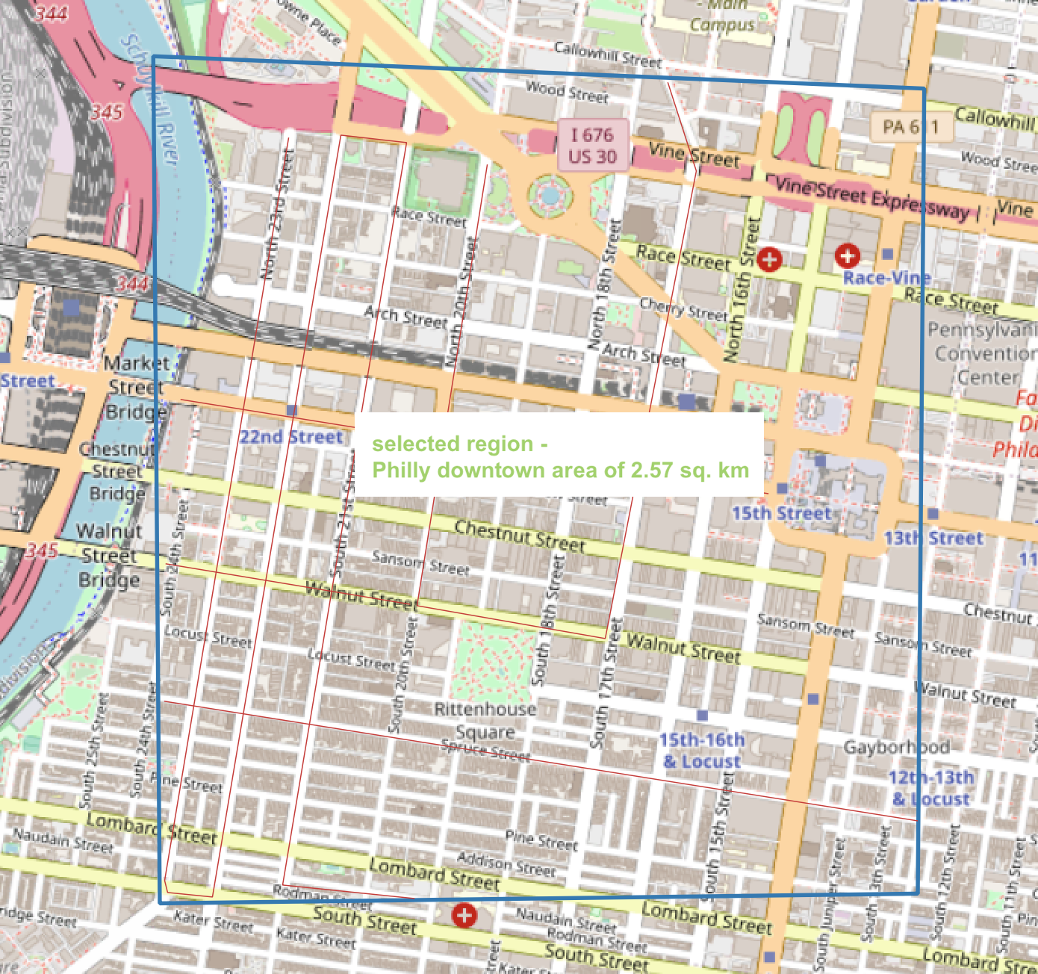
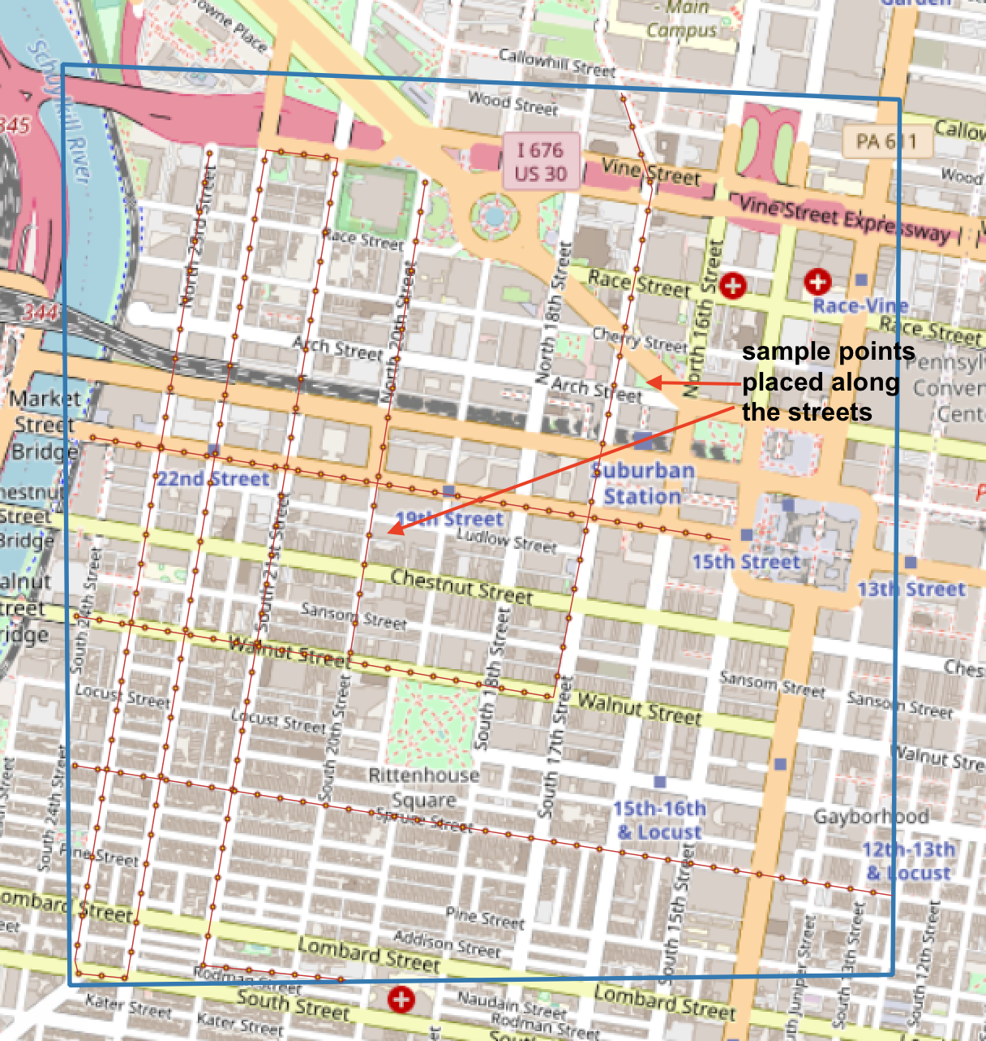
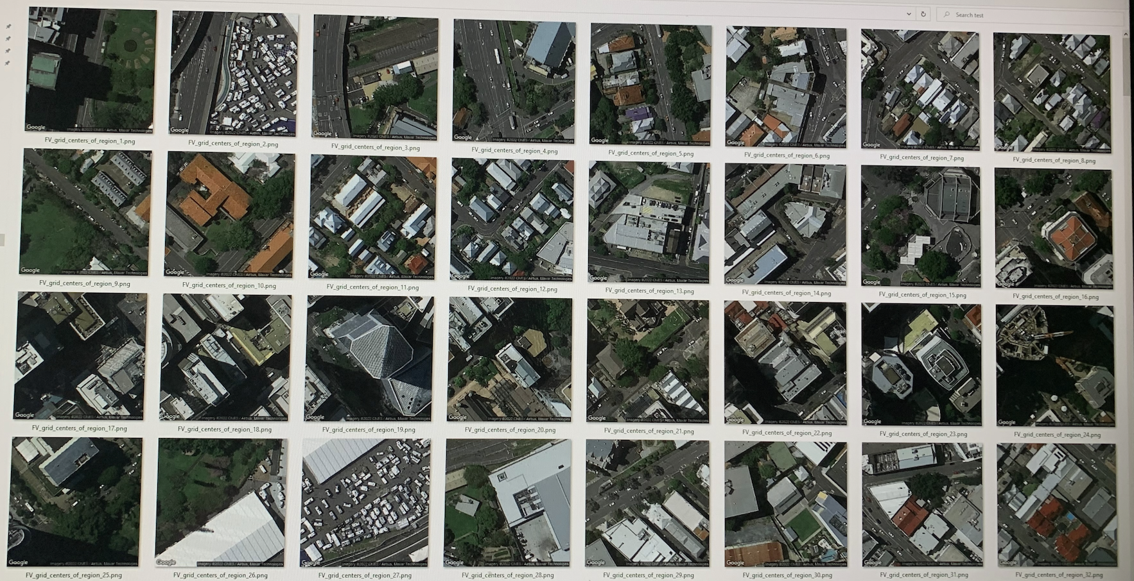
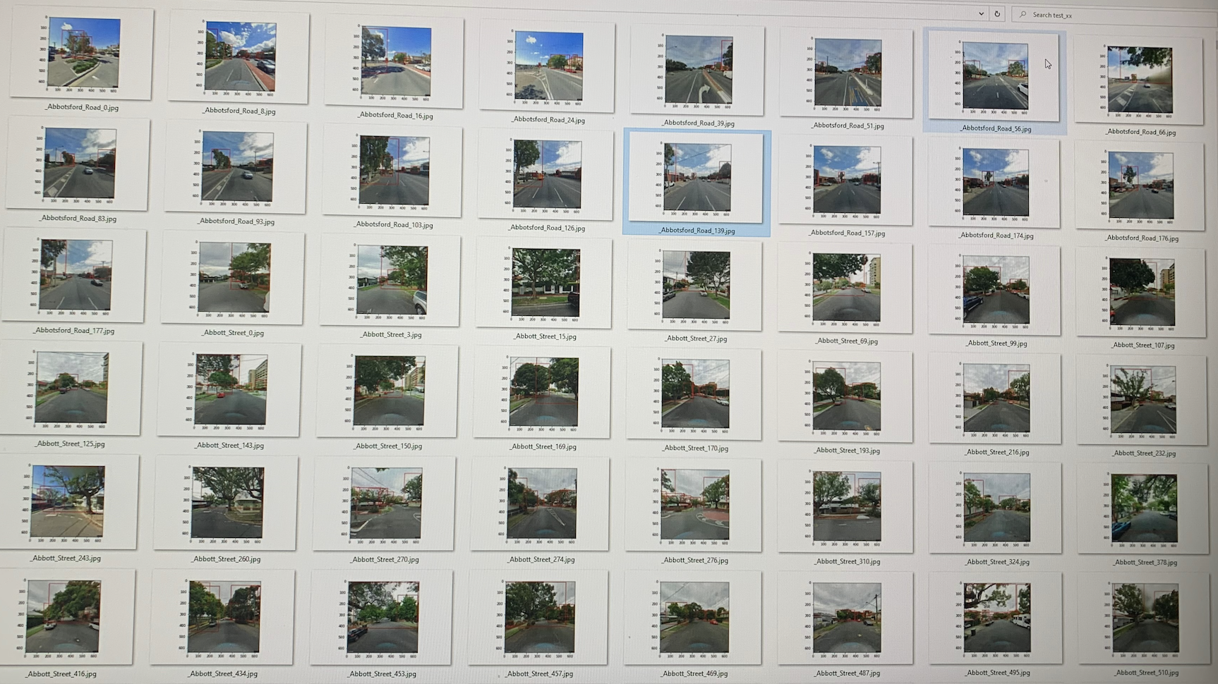
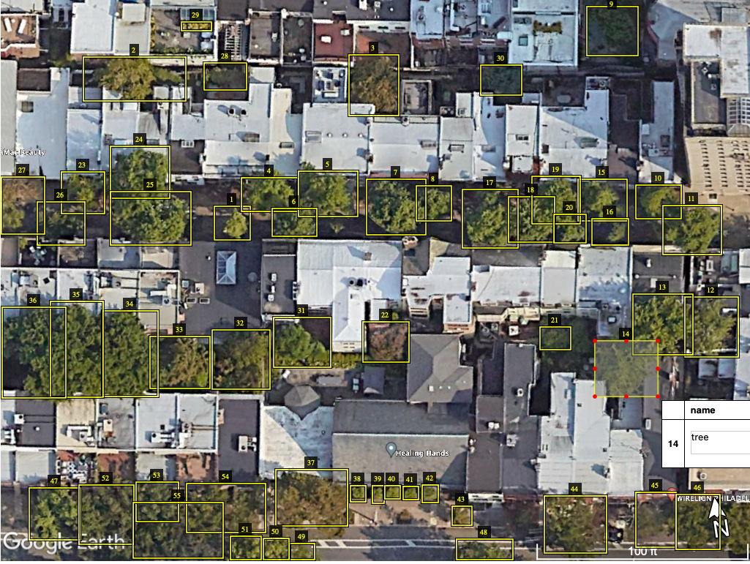
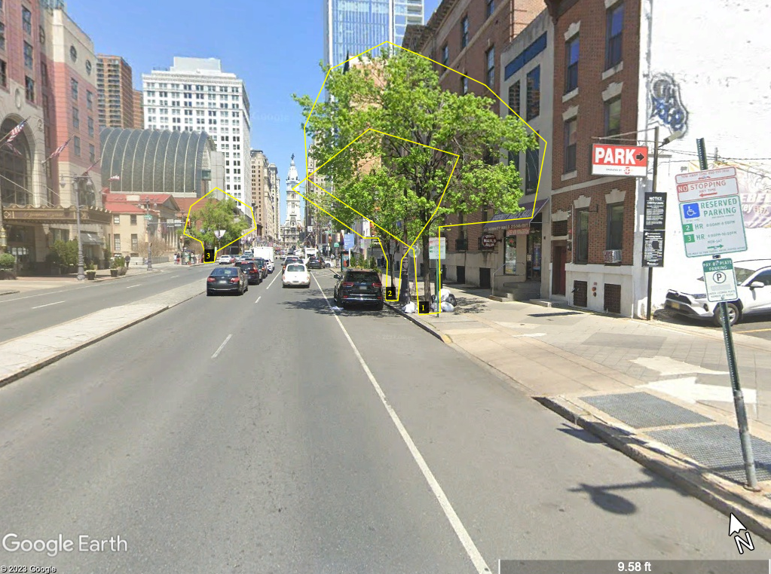
Research Design Data Collection Strategy
Figure 7 A region of Philadelphia downtown.
Figure 8 A region of Philadelphia downtown. With Points placed
Select the region of interest for the creation of a digital twin for foliage.
Create a 640x640 pixel grid with center point and latitude/longitude for the area of interest along the streets using Quantum Geographic Information systems (QGIS).
Using the Google staticmap API, collect aerial view images along these points.
Using the Google Street View static API, collect street view images along these lines.
To train the machine-learning model, add annotations to images with the VGG Image Annotator (VIA).
Figure 9 Aerial view images collected through google API
Figure 10 Street view images collected through google API
Figure 11 Aerial view images annotated using VIA toolI
Figure 12 Street view images annotated using VIA toolI
Notes:
Creating a digital twin for foliage involves a series of strategic steps aimed at gathering comprehensive data and training machine learning models for accurate foliage detection. The process can be broken down into the following key components:
Select the Region of Interest (ROI): The initial step in building a digital twin for foliage is to carefully select the region of interest. This selection is crucial as it determines the scope and extent of the project. Researchers and analysts must identify an area that represents the environment they want to model. This region should be chosen based on specific objectives, such as network planning, ecological studies, or urban development. The ROI serves as the canvas for creating the digital twin and forms the foundation for data collection.
Grid Generation with QGIS: To systematically capture data within the selected ROI, a grid is established. The grid is defined by a fixed size, typically 640x640 pixels, and is centered at a specific point with known latitude and longitude coordinates. Quantum Geographic Information Systems (QGIS) is a powerful open-source tool for this task. By creating this grid, researchers can divide the ROI into manageable sections, ensuring thorough coverage of the area.
Aerial Image Collection with Google Static Maps API: With the grid in place, the next step is to collect aerial view images along the grid points. This is accomplished by utilizing the Google Static Maps API, a valuable resource for accessing high-resolution aerial imagery. The API allows researchers to request images for specific coordinates within the grid. These aerial images provide a top-down perspective of the ROI, contributing to the creation of the digital twin and facilitating the analysis of foliage patterns.
Street View Image Collection with Google Street View Static API: In addition to aerial views, capturing street-level data is essential for comprehensive digital twin creation. This is where the Google Street View Static API comes into play. Researchers can collect street view images along the lines defined by the grid, providing valuable information about the environment's ground-level characteristics. Street view images help in understanding how foliage interacts with urban infrastructure and road networks.
Annotation with VGG Image Annotator (VIA): To train machine learning models for foliage detection, it is crucial to label the collected images. The VGG Image Annotator (VIA) is a user-friendly and efficient tool for adding annotations to the images. Annotations typically include markings or labels indicating the presence or absence of foliage, specific types of vegetation, or any other relevant information. This annotated dataset serves as the training data for the machine learning models, enabling them to learn and recognize foliage accurately.
Following these steps will enable us to create a comprehensive digital twin of the selected region by leveraging aerial imagery as well as street view images. This digital twin, enriched with foliage data, serves as a valuable resource for a wide range of applications, including network planning, environmental monitoring, and urban development.

Slide 4
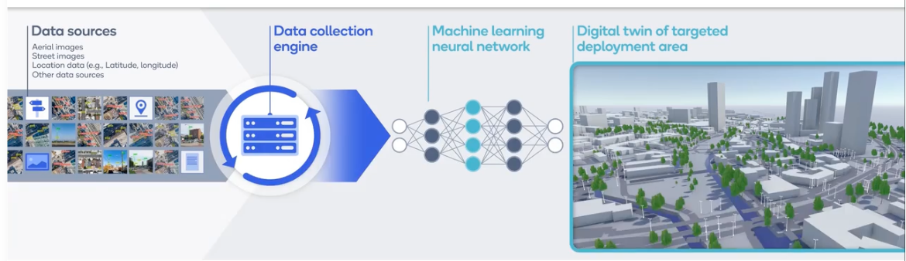
Research Design Data Analysis Strategy
Data preprocessing
Image Feature Extraction
Machine Learning Model Training
Model Evaluation
Data Fusion and Integration
Figure 6 A complete framework to generate Digital Twin Representation of Foliage
A complete framework from data collection, ML training and creating Digital twin.
Note. (MWC23 – Intelligent, 2023).
Notes:
Developing a robust data analysis strategy is essential after collecting the relevant data for creating a digital twin for foliage. The analysis phase aims to extract meaningful insights, detect patterns, and prepare the data for use in various applications, such as network planning or ecological studies. Here's a data analysis strategy for this purpose:
Data preprocessing:
Data Cleaning: Start by cleaning the collected images and annotations. Remove any duplicates, artifacts, or irrelevant images. Ensure that the annotation data is an accurate and consistent representation of foliage/vegetation/trees.
Data Formatting: Standardize the data format, making it compatible with the tools and libraries you plan to use for analysis. Here is a standard format of 640x640 pixels and standard image channels.
Image Feature Extraction:
Feature Extraction: Apply image processing techniques to extract relevant features from images. This could involve extracting color information, texture, and shape characteristics from foliage.
Dimensionality Reduction: If the dataset is large, consider techniques like Principal Component Analysis (PCA) to reduce the dimensionality of the feature vectors.
Machine Learning Model Training:
Model Selection: Develop and train a computer vision model based on mask RCNN to identify and segment foliage in the input images.
Training and Validation: Split the dataset into training and validation sets (80% for training, 20% for validation). Training the machine learning model on the training set and validating its performance using the validation set. Fine-tune the model to improve accuracy.
Model Evaluation:
Testing Set: Reserve a separate testing dataset that the model has never seen during training. This ensures an unbiased evaluation.
Performance Metrics: Evaluate the model's performance using metrics such as accuracy, precision, recall, F1 score, Intersection over Union (IoU) and ROC curves. These metrics help assess the model's ability to detect foliage accurately.
Data Fusion and Integration:
Combine the information extracted from both aerial and street view images to create a comprehensive digital twin. This involves integrating foliage data from different perspectives to obtain a holistic view of the environment.

Slide 5
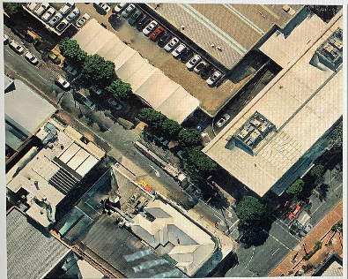
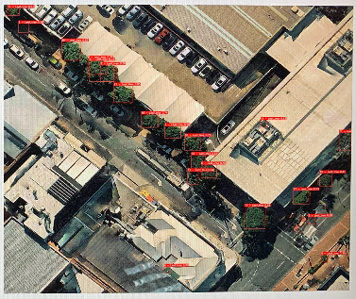
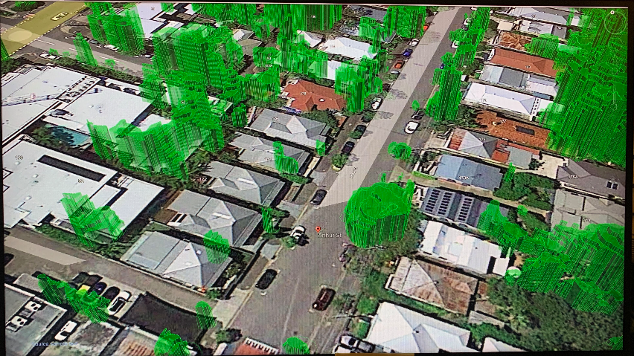
Research Design Data Analysis Strategy
Original image
Image with inference results
Spatial analysis
Temporal analysis
Machine Learning Interpretability
Geospatial Information Systems (GIS) Integration
Visualization and reporting
Iterative Process
Validation and testing
Comparison with LiDAR or UAV Data
Digital twin representation of Foliage
Notes:
Spatial analysis:
Analyze the spatial distribution of foliage within the ROI. This can involve techniques like geospatial analysis and clustering to identify areas with high or low foliage density.
Temporal analysis:
If data is collected over multiple time points, analyze temporal trends in foliage growth and changes. This is particularly relevant to ecological studies.
Machine Learning Interpretability:
Ensure that the machine learning model’s decisions are interpretable. This involves techniques like feature visualization and saliency maps to understand which image regions contribute most to foliage detection.
Geospatial Information Systems (GIS) Integration:
If available, integrate the foliage data with GIS information to enable more advanced geospatial analyses. This can include overlaying foliage information on land cover data or urban development plans.
Visualization and reporting:
Create visualizations to present the findings effectively. Utilize maps, charts, and graphs to communicate the resultsto stakeholders, decision-makers, or researchers.
Generate reports summarizing the key insights and findings from the analysis.
Iterative Process:
Data analysis is often an iterative process. As you gain insights and refine your models, you may need to revisit previous steps to improve the quality of your digital twin and analysis.
Validation and testing:
Conduct thorough validation and testing of the entire digital twin, ensuring that it accurately represents the environment and can be used effectively for its intended purpose.
Comparison with LiDAR or UAV Data:
Compare the foliage measurements obtained from the DT model with known LiDAR or UAV datasets.
Partition the study area into grids (e.g., one square meter) to facilitate comparisons.
Visualize the intersection of foliage data from the DT model and LiDAR or UAV using Venn diagrams.
By following this data analysis strategy, you can extract valuable insights from the collected data and create a digital twin that serves as a powerful resource for applications ranging from network planning to ecological research.

Slide 6
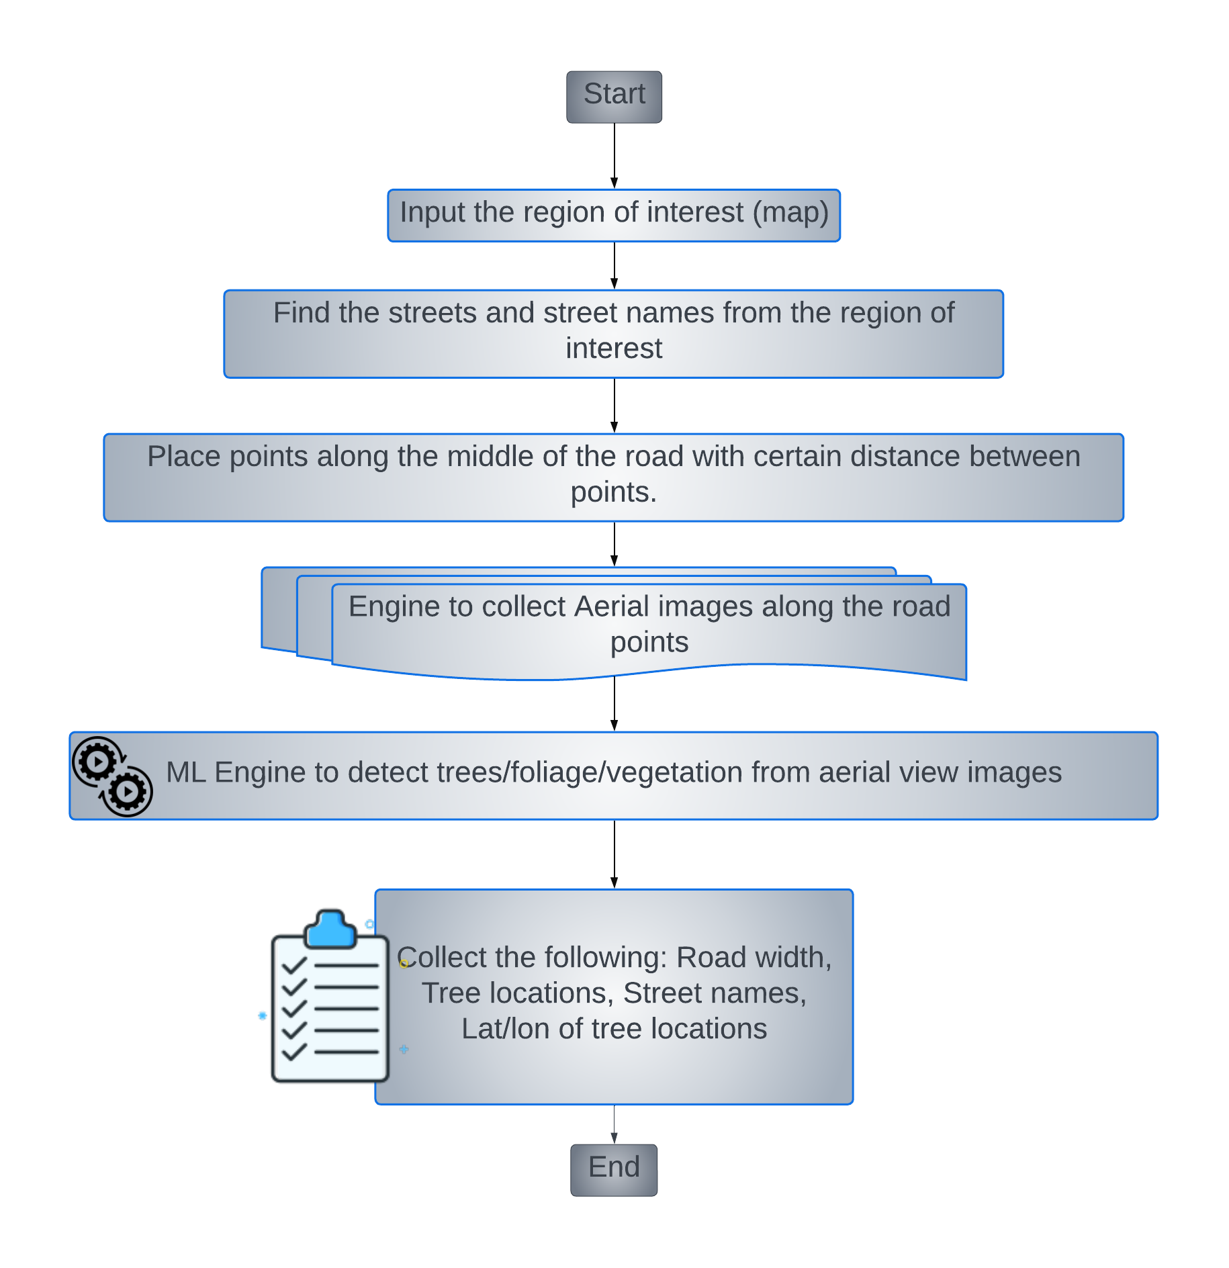





Steps to collect aerial view images
Input area of the map (region of interest)
Find the streets and street names from the region of interest
Place points along the middle of the road with certain distance between points.
Engine to collect Aerial images along the road points
ML Engine to detect trees from aerial view images

Slide 7
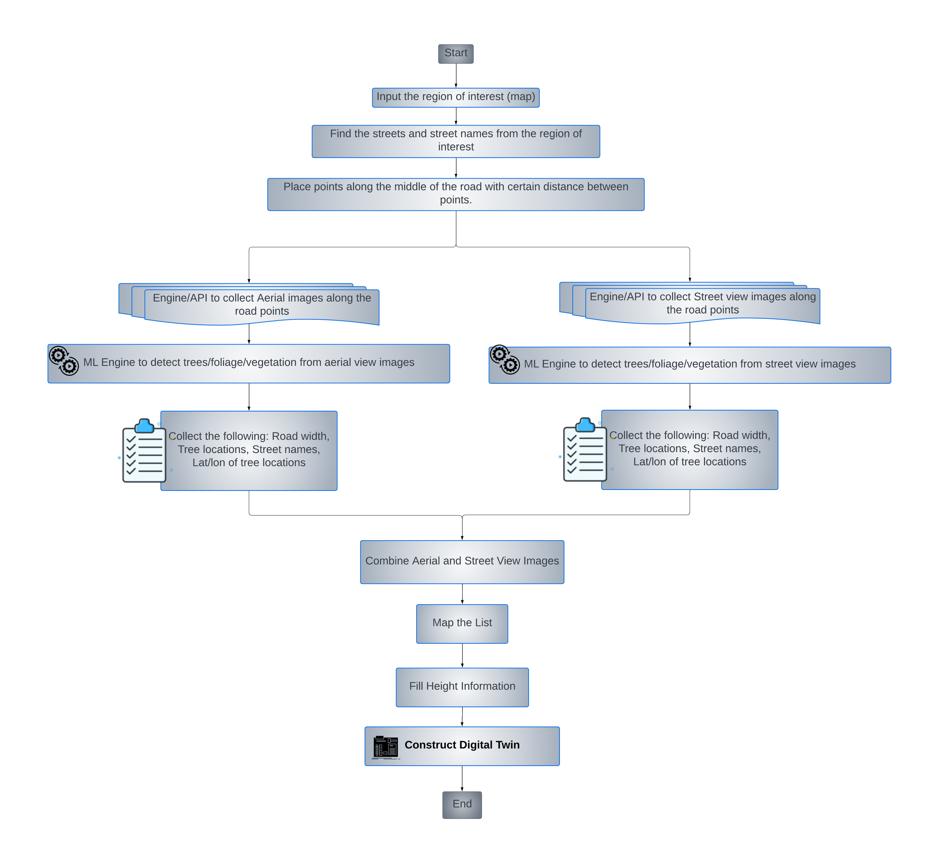
AI-Driven Foliage Detection Using Machine Learning and Computer Vision - flowchart
Input the region of interest
Find the streets and street names from the region of interest
Place points along the middle of the road with certain distance between points.
Engine to collect Aerial images along the road points
ML Engine to detect trees from aerial view images
From previous two steps, collect the following:
Road width
Tree locations
Street names
Lat/lon of tree locations
Engine to collect Street view images
ML engine to detect trees from street view images
From the above steps previous two steps, collect the following:
Height information of Tree positions
Mapping of satellite view to street view images
Map the information collected in steps 6 & 9.
Derive the estimated true height of Trees list
Construct the Digital Twin representation of the trees with height.

Slide 8


Resources
Adhikari, S. (2023). Leaf Area Index and Aboveground Biomass Estimation of Populus and Its Hybrids Using Terrestrial LiDAR [Doctoral dissertation, Mississippi State University]. (Order No. 30574277). Available From Proquest Dissertations & Theses Global. (2851780250). https://www.proquest.com/dissertations-theses/leaf-area-index-aboveground-biomass-estimation/docview/2851780250/se-2?accountid=25320
Aikoh, T., Homma, R., & Abe, Y. (2023). Comparing conventional manual measurement of the green view index with modern automatic methods using Google Street View and semantic segmentation. Urban Forestry & Urban Greening, 80, N.PAG. https://doi.org/10.1016/j.ufug.2023.127845
Airborne laser scanning. (2013, January 18). Geospatial Modeling & Visualization | A Method Store for Advanced Survey and Modeling Technologies. https://gmv.cast.uark.edu/scanning-2/airborne-laser-scanning/
Algarni, S. K. (2022). Machine Learning for Improved Detection and Segmentation of Building Boundary [Doctoral dissertation, Cardiff University (United Kingdom)]. ProQuest Dissertations and Theses Global. https://www.proquest.com/dissertations-theses/machine-learning-improved-detection-segmentation/docview/2796423951/se-2?accountid=25320
Barricelli, B. R., Casiraghi, E., & Fogli, D. (2019). A Survey on Digital Twin: Definitions, Characteristics, Applications, and Design Implications. IEEE Access, 7, 167671. https://doi.org/10.1109/ACCESS.2019.2953499
Brennen, J. S., & Kreiss, D. (2016). Digitalization. In The International Encyclopedia of Communication Theory and Philosophy (pp. 1–11). In The International Encyclopedia of Communication Theory and Philosophy (eds K.B. Jensen, E.W. Rothenbuhler, J.D. Pooley and R.T. Craig). https://doi.org/10.1002/9781118766804.wbiect111
Brinkhoff, T. (2016). OPEN STREET MAP DATA AS A SOURCE FOR BUILT-UP AND URBAN AREAS ON GLOBAL SCALE. The International Archives of the Photogrammetry, Remote Sensing and Spatial Information Sciences, XLI-B4, 557–564. https://doi.org/10.5194/isprs-archives-XLI-B4-557-2016
Chen, Q., Gao, T., Zhu, J., Wu, F., Li, X., Lu, D., & Yu, F. (2022). Individual Tree Segmentation and Tree Height Estimation Using Leaf-Off and Leaf-On UAV-LiDAR Data in Dense Deciduous Forests. Remote Sensing, 14, 2787. https://doi.org/10.3390/ rs14122787
Dutta, A., & Zisserman, A. (2019). The VIA Annotation Software for Images, Audio, and Video. https://doi.org/10.1145/3343031.3350535
Notes:
The following is a list of the resources used and the references that were cited in the process of conducting the study on the creation of the digital twin for foliage.

Slide 9
Resources
Gabriele, M., Cazzani, A., Zerbi, C. M., & Brumana, R. (2023). DIGITAL TWIN TO MONITOR, UNDERSTAND AND PRESERVE THE COMPLEXITY OF MULTI-SCALE NATURAL, AGRICULTURAL, DESIGNED LANDSCAPES AND ARCHITECTURE: BIODIVERSITY CONSERVATION, TRANSFORMATION AND DECLINE AT VILLA ARCONATI SITE AT CASTELLAZZO OF BOLLATE (MI). International Archives of the Photogrammetry, Remote Sensing & Spatial Information Sciences, 48(M/2), 613–620. https://doi.org/10.5194/isprs-archives-XLVIII-M-2-2023-613-2023
Google for developers Maps Static API. (n.d.). Google for Developers. https://developers.google.com/maps/documentation/maps-static/start
Google for developers street view static API overview. (n.d.). Google for Developers. https://developers.google.com/maps/documentation/streetview/overview
Google-contributed street view imagery policy. (n.d.). Google Maps Street View. https://www.google.com/streetview/policy/
Govindasamy Raman, M. (2022). Sensor-Based Evaluation of Architectural Traits in Tree Fruits [Doctoral dissertation, Washington State University]. (Order No. 29993898). Available From Proquest Dissertations & Theses Global. (2836748837). https://www.proquest.com/dissertations-theses/sensor-based-evaluation-architectural-traits-tree/docview/2836748837/se-2?accountid=25320
Hematang, F., Murdjoko, A., Hendri, H., & Tokede, M. (2022). Application of Unmanned Aerial Vehicle (UAV) For Estimation of Tree Height in Heterogeneous Forest. Biosaintifika: Journal of Biology & Biology Education, 14(2), 168–179. https://doi.org/http://dx.doi.org/10.15294/biosaintifika.v14i2.35637
Huabing, H., Zhan, L., Peng, G., Xiao, C., Clinton, N., Chunxiang, C., Wenjian, N., & Lei, W. (2011). Automated Methods for Measuring DBH and Tree Heights with a Commercial Scanning Lidar. Photogrammetric Engineering & Remote Sensing, 77(3), 219–227. https://doi.org/10.14358/PERS.77.3.219
Johnson, K. A. (2023). Phony Peach Disease: New Insights Relative to Identification, Detection, and Management [Doctoral dissertation, University of Georgia]. (Order No. 30250404). Available From Proquest Dissertations & Theses Global. (2825739565). https://www.proquest.com/dissertations-theses/phony-peach-disease-new-insights-relative/docview/2825739565/se-2?accountid=25320
Notes:
The following is a list of the resources used and the references that were cited in the process of conducting the study on the creation of the digital twin for foliage.

Slide 10
Resources
Kin, L. C., Torrico, S.A., & Kurner, T. (2011). Foliage Attenuation Over Mixed Terrains in Rural Areas for Broadband Wireless Access at 3.5 GHz. IEEE Transactions on Antennas and Propagation, Antennas and Propagation, IEEE Transactions on, IEEE Trans. Antennas Propagat, 59(7), 2698–2706. https://doi.org/10.1109/TAP.2011.2152340
Loaiza, J. H. (2023). Towards Developing a Digital Twin Implementation Framework for Manufacturing Systems [Doctoral dissertation, University of South Alabama]. (Order No. 30318094). Available From Proquest Dissertations & Theses Global. (2796293099). https://www.proquest.com/dissertations-theses/towards-developing-digital-twin-implementation/docview/2796293099/se-2?accountid=25320
Long, J., Shelhamer, E., & Darrell, T. (2015). Fully convolutional networks for semantic segmentation [Paper]. 2015 IEEE Conference on Computer Vision and Pattern Recognition (CVPR). https://doi.org/10.1109/CVPR.2015.7298965
Mask R-CNN. (2018). arXiv.org. https://doi.org/10.48550/arXiv.1703.06870
Meng, Y. S., & Lee, Y. H. (2010). INVESTIGATIONS OF FOLIAGE EFFECT ON MODERN WIRELESS COMMUNICATION SYSTEMS: A REVIEW. Progress in Electromagnetics Research, 105, 313–332.
Muhammad, N.A., Rahman, T.A., & Rahim, S.K.A. (2010). The effects of foliage on 5.8GHz Broadband Fixed Wireless Access (BFWA). https://doi.org/10.1109/APACE.2010.5719760
MWC23 – Intelligent 5G mmWave network planning. (2023, February 27). Wireless Technology & Innovation | Mobile Technology | Qualcomm.
Nanda, V. M. V. (2023). Estimating and Modeling Structural Characteristics of Trees Within Aerial LiDar Data [Doctoral dissertation, North Carolina State University]. (Order No. 30516438). Available From Proquest Dissertations & Theses Global. (2838440130). https://www.proquest.com/dissertations-theses/estimating-modeling-structural-characteristics/docview/2838440130/se-2?accountid=25320
Nowak, D. J., Bodine, A. R., Hoehn, R., Ellis, A., Low, S. C., Roman, L. A., Henning, J. G., Stephan, E., Taggert,, T., & Endreny, T. (2016). The urban forests of Philadelphia. U.S. Department of Agriculture, Forest Service, Northern Research Station. http://dx.doi.org/10.2737/NRS-RB-106
Pradeep, T., Shukla, N. K., Animesh, T., & Shiv, P. (2021). Investigate the Effect of Rain, Foliage, Atmospheric Gases, and Diffraction on Millimeter (mm) Wave Propagation for 5G Cellular Networks. https://doi.org/10.1007/978-981-16-3346-1_42
Notes:
The following is a list of the resources used and the references that were cited in the process of conducting the study on the creation of the digital twin for foliage.

Slide 11
Resources
QGIS: A Free and Open Source Geographic Information System [Computer software]. (n.d.). http://Qgis.org
Qi, Q., & Tao, F. (2018). Digital Twin and Big Data Towards Smart Manufacturing and Industry 4.0: 360 Degree Comparison. IEEE Access, 6, 3593. https://doi.org/10.1109/ACCESS.2018.2793265
Rahim, H. M., Leow, C. Y., Rahman, T. A., Arsad, A., & Malek, M. A. (2017). Foliage attenuation measurement at millimeter wave frequencies in tropical vegetation [Paper]. 2017 IEEE 13th Malaysia International Conference on Communications (MICC), Johor Bahru, Malaysia. https://doi.org/10.1109/MICC.2017.8311766
Reny, S. A. (2023). The Estimation of Forest Inventory Biometrics Using UAS-Lidar Technology [Doctoral dissertation, University of New Hampshire]. https://www.proquest.com/dissertations-theses/estimation-forest-inventory-biometrics-using-uas/docview/2864399766/se-2?accountid=25320
Rezatofighi, H., Tsoi, N., Gwak, J., Sadeghian, A., Reid, I., & Savarese, S. (2019). Generalized Intersection over Union: A Metric and A Loss for Bounding Box Regression. http://arxiv.org/abs/1902.09630
Scientists measure impact of trees on 5G mmWave signal propagation. (2022, January 27). everything RF - The leading website for the RF & Microwave Industry. https://www.everythingrf.com/news/details/13843-scientists-measure-impact-of-trees-on-5g-mmwave-signal-propagation
Shah, R. (2018, November 9). Psst, says 5G... Wanna see what my new antenna tech challenge looks like? Semiconductor Engineering. https://semiengineering.com/psst-says-5g-wanna-see-what-my-new-antenna-tech-challenge-looks-like/
Shen, Y., Huang, R., Hua, B., Pan, Y., Mei, Y., & Dong, M. (2023). Automatic Tree Height Measurement Based on Three-Dimensional Reconstruction Using Smartphone. Sensors 2023, 23(16), 7248. https://doi.org/10.3390/ s23167248
Song, J., Zhao, Y., Song, W., Zhou, H., Zhu, D., Huang, Q., Fan, Y., & Lu, C. (2022). Fisheye Image Detection of Trees Using Improved YOLOX for Tree Height Estimation. Sensors, 22, 3636. https://doi.org/10.3390/s22103636
Suhaizad, L. S., Khalid, N., & Abu Sari, M. Y. (2023). Tree Height and Crown Extraction From UAV-Based Multispectral Imagery. International Journal of Geoinformatics, 19(5), 61–68. https://doi.org/10.52939/ijg.v19i5.2661
Thuvander, L., Somanath, S., & Hollberg, A. (2022). PROCEDURAL DIGITAL TWIN GENERATION FOR CO-CREATING IN VR FOCUSING ON VEGETATION. International Archives of the Photogrammetry, Remote Sensing & Spatial Information Sciences, 48(4/W5), 189–196. https://doi.org/10.5194/isprs-archives-XLVIII-4-W5-2022-189-2022
Notes:
The following is a list of the resources used and the references that were cited in the process of conducting the study on the creation of the digital twin for foliage.

Slide 12
Resources
Zhang, Y., Anderson, C. R., Michelusi, N., Love, D. J., Baker, K. R., & Krogmeier, J. V. (2019). Propagation Modeling Through Foliage in a Coniferous Forest at 28 GHz. IEEE Wireless Communications Letters, 8(3), 901–904.
Zhao, D., Li, X., Wang, X., Shen, X., & Gao, W. (2022). Applying Digital Twins to Research the Relationship Between Urban Expansion and Vegetation Coverage: A Case Study of Natural Preserve. Frontiers in Plant Science, 13, 840471. https://doi.org/10.3389/fpls.2022.840471
Zhong, Y., Yang, Y., Zhu, X., Huang, Y., Dutkiewicz, E., Zhou, Z., & Jiang, T. (2018). Impact of Seasonal Variations on Foliage Penetration Experiment: A WSN-Based Device-Free Sensing Approach. IEEE Transactions on Geoscience & Remote Sensing, 56(9), 5035–5045. https://doi.org/10.1109/TGRS.2018.2804346
Notes:
The following is a list of the resources used and the references that were cited in the process of conducting the study on the creation of the digital twin for foliage.

Slide 13
Thank You!!
Notes:
This concludes my presentation on digital twin representation of foliage. It was a pleasure to present to you. I appreciate your time.

Slide 14

BackUp

Slide 15
Research Design Data Collection Strategy
Figure (a) A region of Philadelphia downtown.
Figure (b) A region of Philadelphia downtown. With Points placed
(a) Select the region of interest for the creation of a digital twin for foliage.
(b) Create a 640x640 pixel grid with center point and latitude/longitude for the area of interest along the streets using Quantum Geographic Information systems (QGIS).
(c) Using the Google staticmap API, collect aerial view images along these points.
(d) Using the Google Street View static API, collect street view images along these lines.
(e.1,e.2) To train the machine-learning model, add annotations to images with the VGG Image Annotator (VIA).
Figure (c) Aerial view images collected through google API
Figure (d) Street view images collected through google API
Figure (e.1) Aerial view images annotated using VIA toolI
Figure (e.2) Street view images annotated using VIA toolI
Notes:
Creating a digital twin for foliage involves a series of strategic steps aimed at gathering comprehensive data and training machine learning models for accurate foliage detection. The process can be broken down into the following key components:
Select the Region of Interest (ROI): The initial step in building a digital twin for foliage is to carefully select the region of interest. This selection is crucial as it determines the scope and extent of the project. Researchers and analysts must identify an area that represents the environment they want to model. This region should be chosen based on specific objectives, such as network planning, ecological studies, or urban development. The ROI serves as the canvas for creating the digital twin and forms the foundation for data collection.
Grid Generation with QGIS: To systematically capture data within the selected ROI, a grid is established. The grid is defined by a fixed size, typically 640x640 pixels, and is centered at a specific point with known latitude and longitude coordinates. Quantum Geographic Information Systems (QGIS) is a powerful open-source tool for this task. By creating this grid, researchers can divide the ROI into manageable sections, ensuring thorough coverage of the area.
Aerial Image Collection with Google Static Maps API: With the grid in place, the next step is to collect aerial view images along the grid points. This is accomplished by utilizing the Google Static Maps API, a valuable resource for accessing high-resolution aerial imagery. The API allows researchers to request images for specific coordinates within the grid. These aerial images provide a top-down perspective of the ROI, contributing to the creation of the digital twin and facilitating the analysis of foliage patterns.
Street View Image Collection with Google Street View Static API: In addition to aerial views, capturing street-level data is essential for comprehensive digital twin creation. This is where the Google Street View Static API comes into play. Researchers can collect street view images along the lines defined by the grid, providing valuable information about the environment's ground-level characteristics. Street view images help in understanding how foliage interacts with urban infrastructure and road networks.
Annotation with VGG Image Annotator (VIA): To train machine learning models for foliage detection, it is crucial to label the collected images. The VGG Image Annotator (VIA) is a user-friendly and efficient tool for adding annotations to the images. Annotations typically include markings or labels indicating the presence or absence of foliage, specific types of vegetation, or any other relevant information. This annotated dataset serves as the training data for the machine learning models, enabling them to learn and recognize foliage accurately.
Following these steps will enable us to create a comprehensive digital twin of the selected region by leveraging aerial imagery as well as street view images. This digital twin, enriched with foliage data, serves as a valuable resource for a wide range of applications, including network planning, environmental monitoring, and urban development.

Slide 16
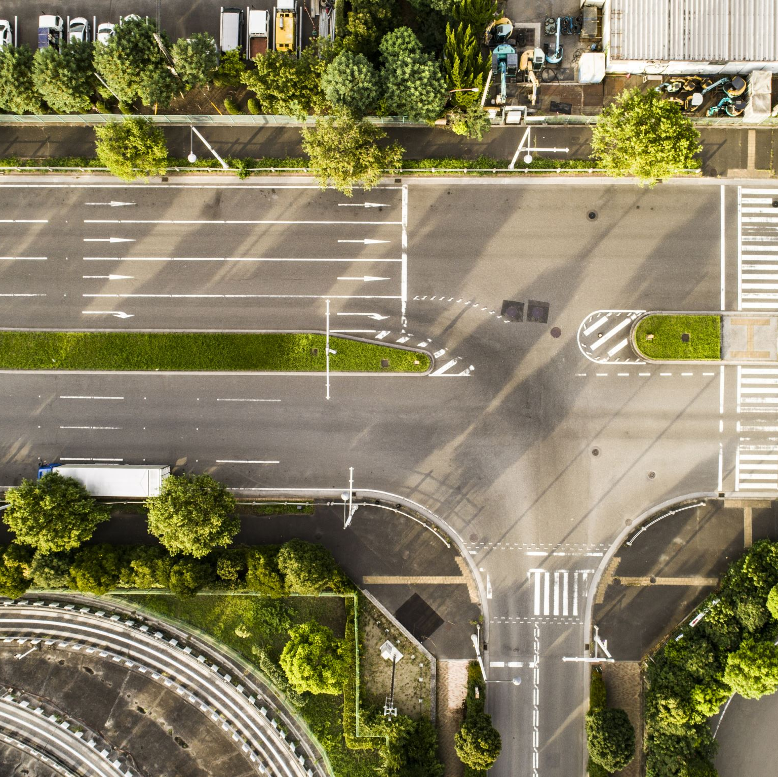
Steps to collect Street view images
Engine to collect Street view images
ML engine to detect trees from street view images
From the above steps previous two steps, collect the following:
Height information of Tree positions
Mapping of satellite view to street view images
Map the information collected in steps 6 & 9.
Derive the estimated true height of Trees list
Construct the Digital Twin representation of the trees with height.

